Slide 1


By Madeliene Edwards

Slide 2
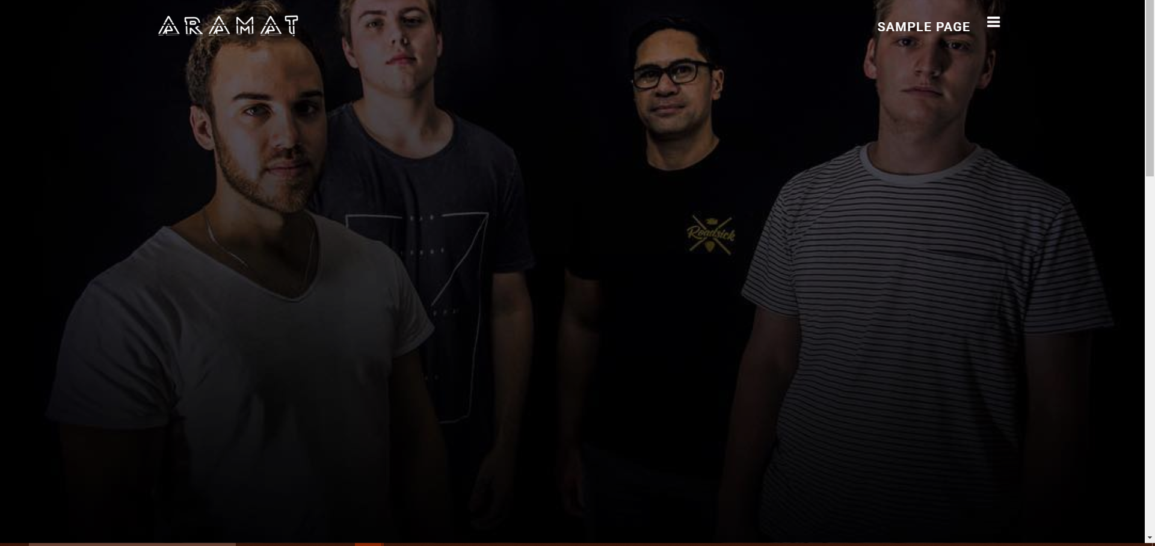
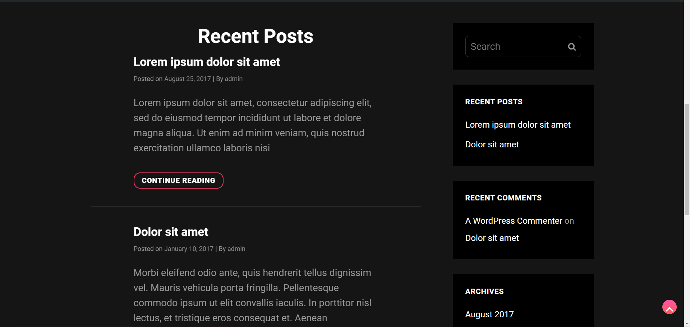
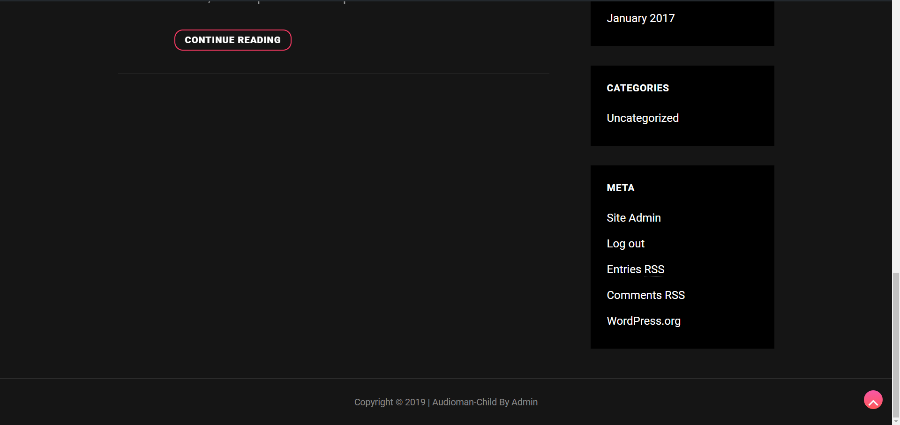
Prototype 1

Slide 3

What it could look?

Slide 4

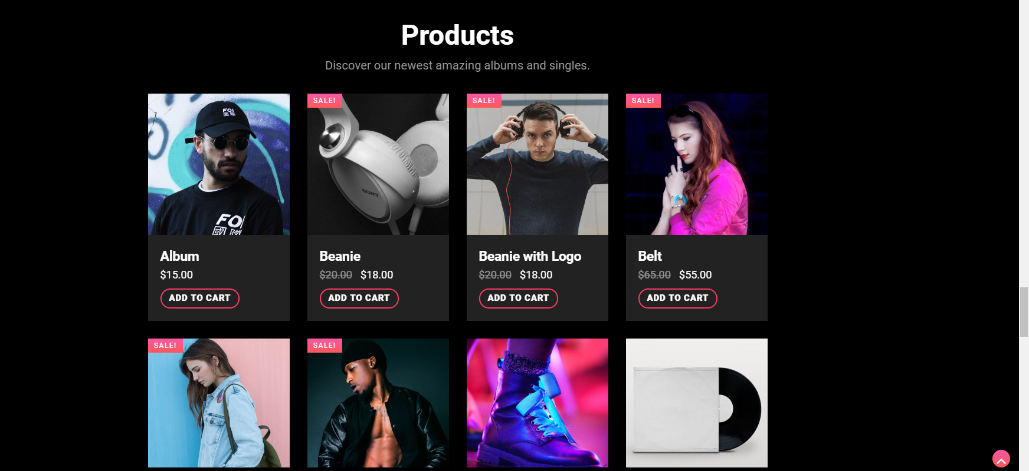

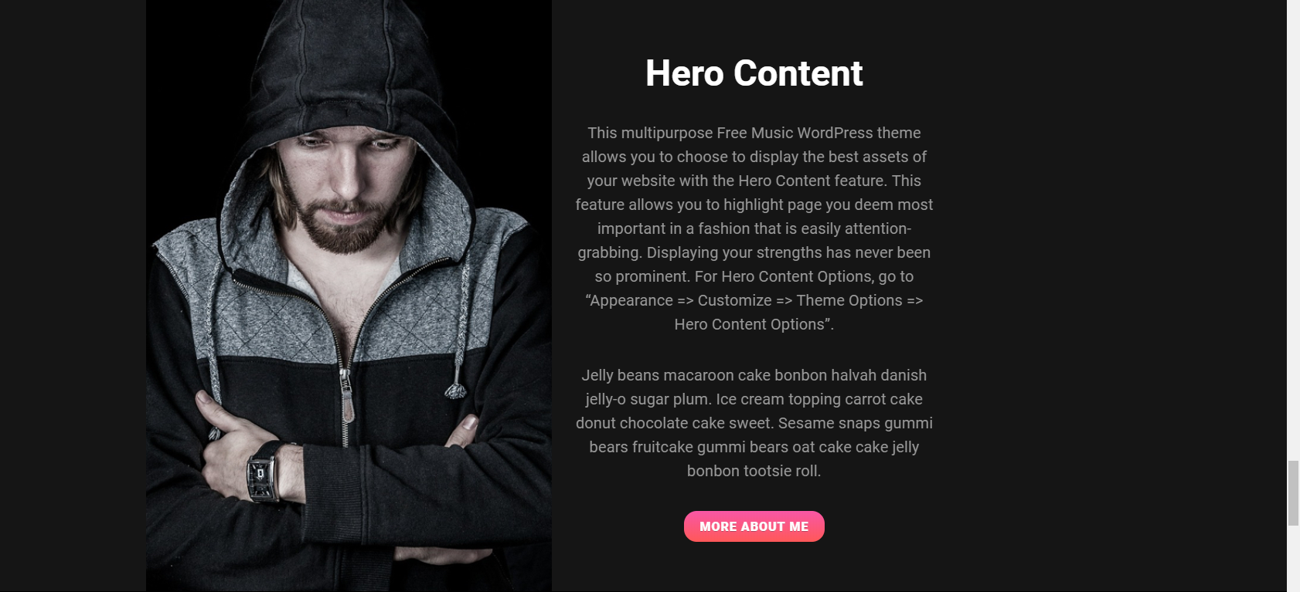
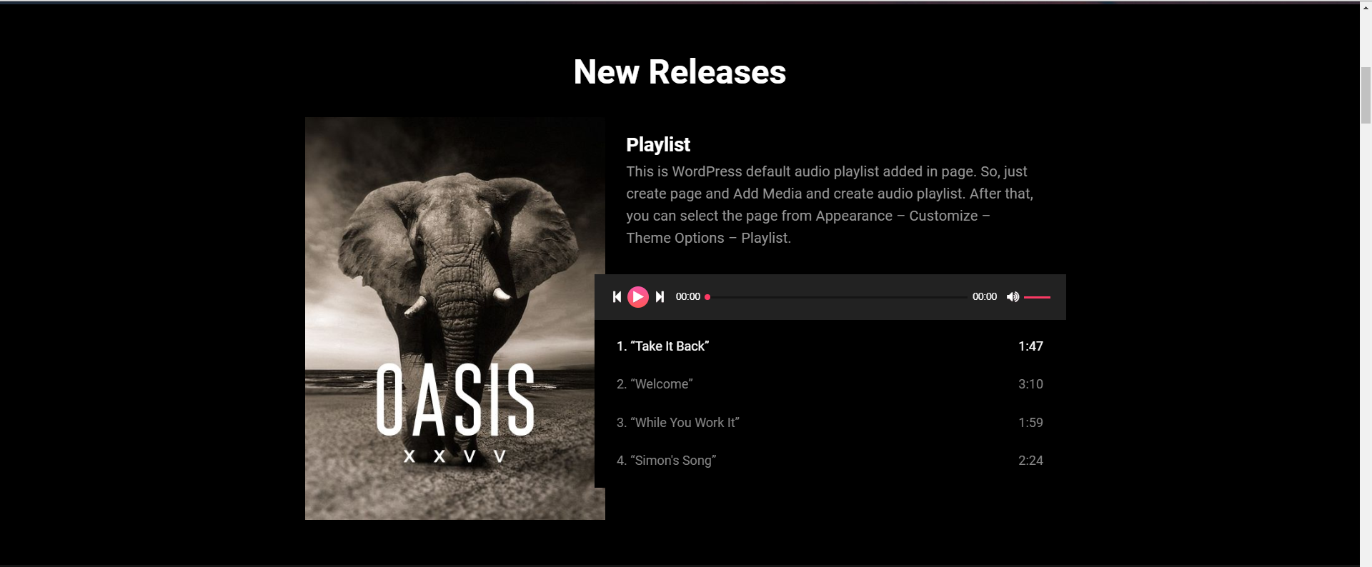

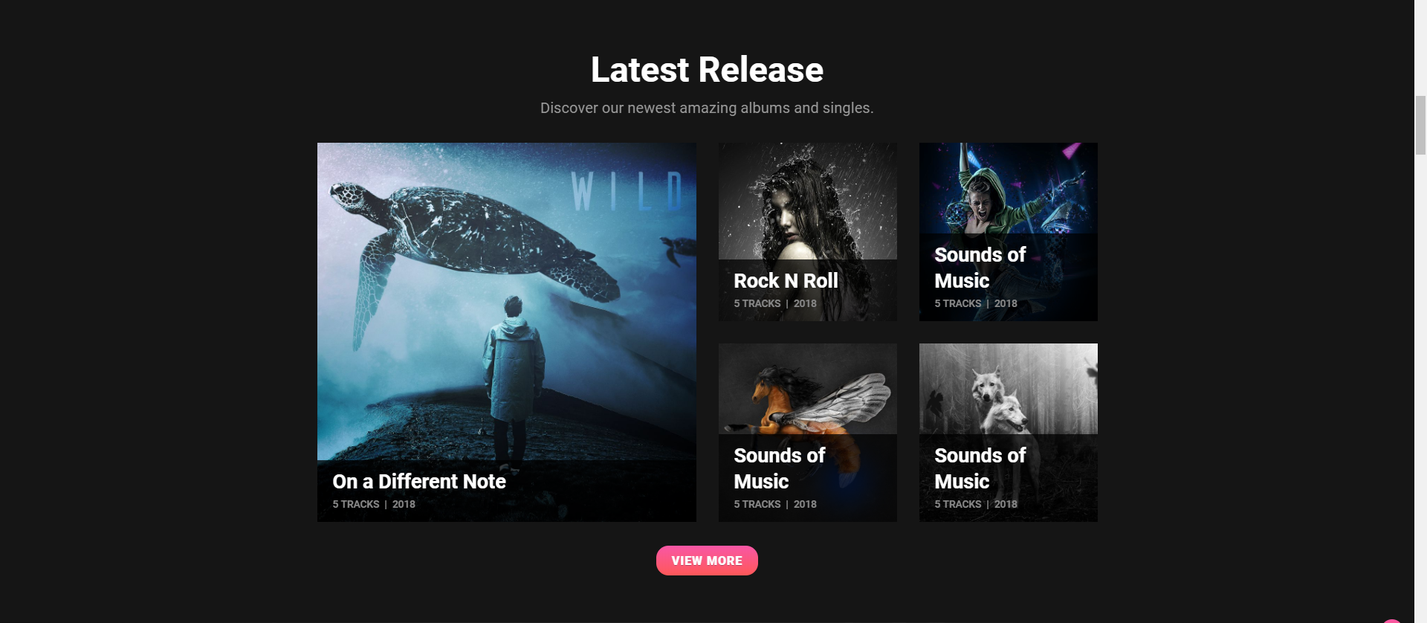
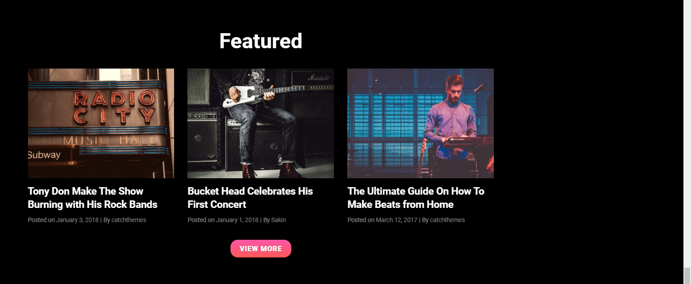


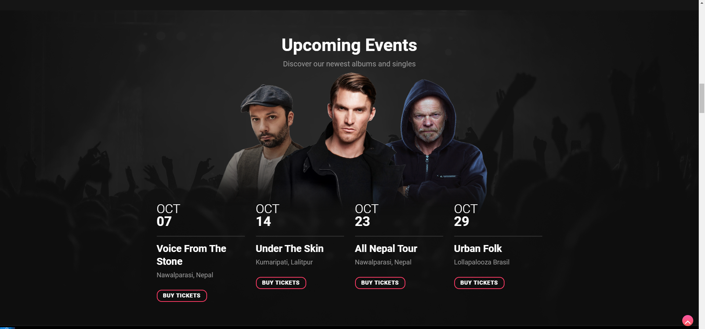
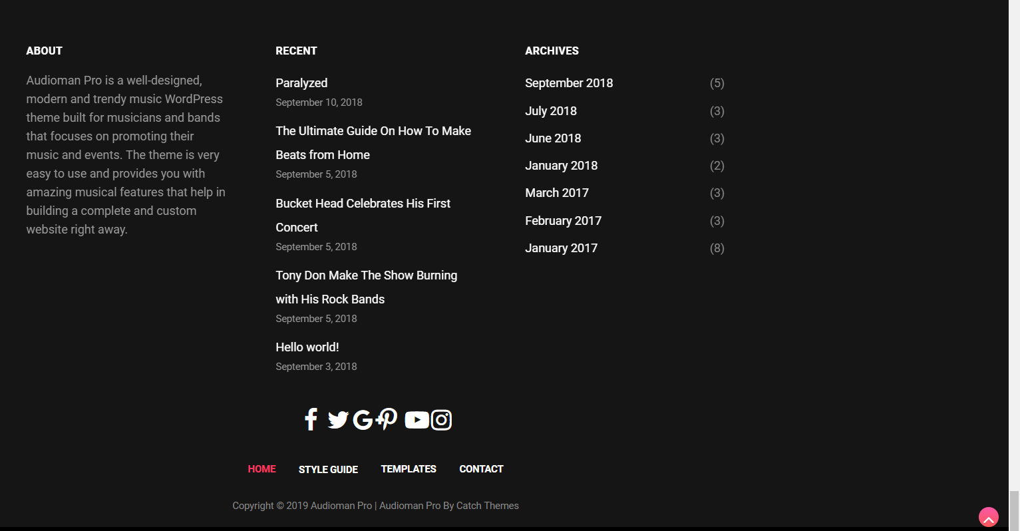


Slide 5
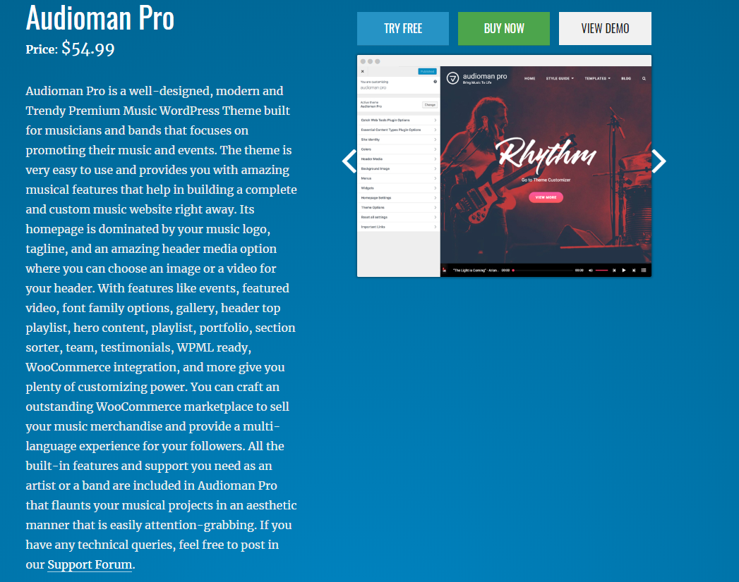
Plan
https://catchthemes.com/themes/audioman/#theme-instructions,

Slide 6
Plugins
WooCommerce Ready!

Slide 7
Features
Theme Options
Theme Options allow you to toggle on and off features, adjust layouts, change colors, fonts, logo, favicon, background, add social links and custom CSS.
Responsive Design
Adapt to different screen sizes delivering an optimized design for iPhones, iPads, and other mobile devices.
Incredible Support
Great line of support team and support documentation.
WordPress Standard Codes
proper data validation and sanitization and follow core theme guidelines. Our developers are active contributors to WordPress theme review and WordPress core. Our themes will always be updated as things change in WordPress.

Slide 8
$54.99
Price?
+
Hosting Price

Slide 9

WordPress Web Hosting

Slide 10
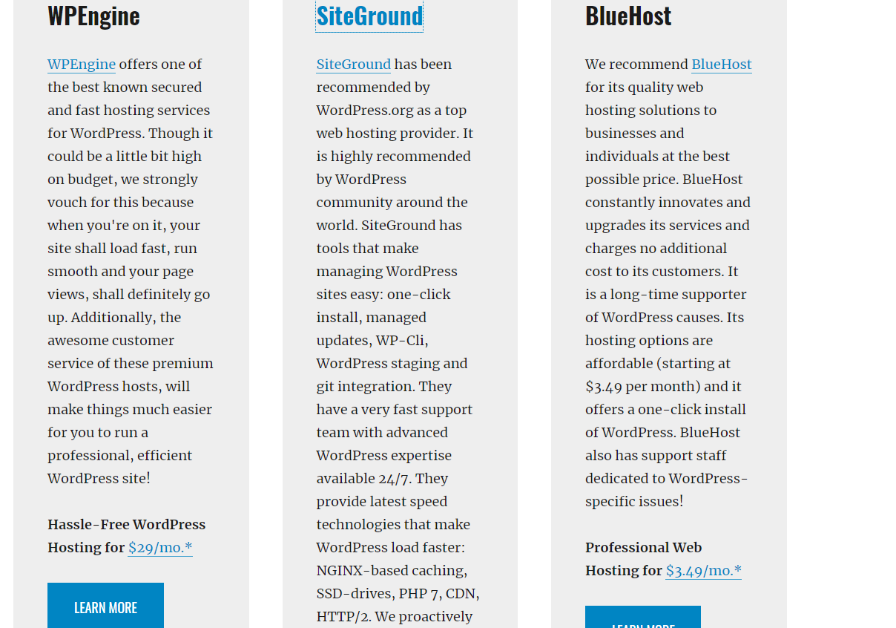
Hosting Recommendation
https://catchthemes.com/wordpress-web-hosting/

Slide 11

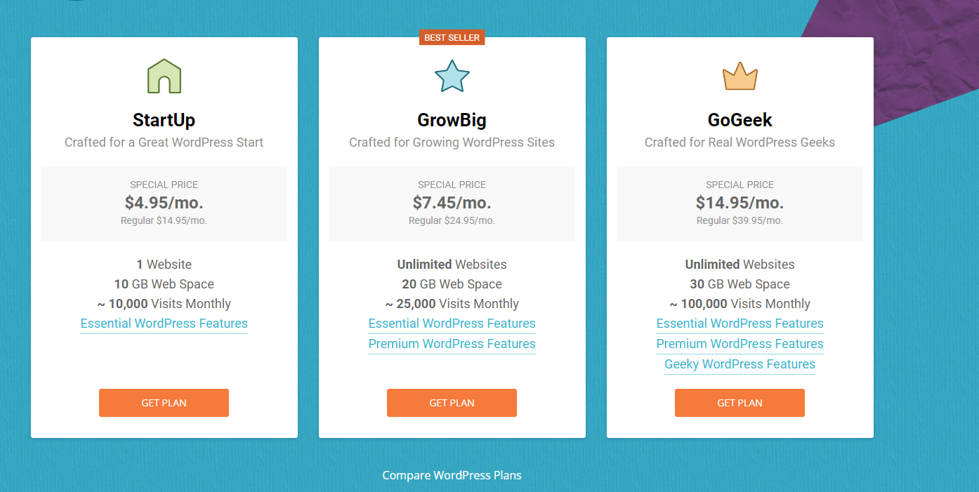
Hosting
BlueHost
https://www.bluehost.com/?utm_source=catchthemes.com&utm_medium=affiliate&utm_campaign=affiliate-link_catchthemes_notype
SiteGround
https://www.siteground.com/wordpress-hosting.htm?afbannercode=3c2da959fa457fd73d83f7d5e0567ac0

Slide 12
Thank You For Listening !

